Slide 1
Swiggy Data Analysis
- Gathram Kesava Murthy

Slide 2
ABSTRACT
This report presents an analysis of Swiggy's restaurant data using exploratory data analysis (EDA). The primary goal is to uncover trends in ratings, costs, and cuisine popularity. The analysis aims to provide actionable insights for Swiggy and restaurant owners to improve customer engagement and operational efficiency.

Slide 3
INTRODUCTION
2.1 Aim:
Analyze restaurant data for meaningful insights to enhance business strategies.
2.2 Objectives:
Identify trends in restaurant ratings and customer preferences.
Understand cost variations and cuisine popularity.
Examine city-specific restaurant performance.
2.3 Proposed System:
A Python-based EDA system leveraging Pandas, NumPy, and visualization tools.
2.4 Benefit of Study:
Enables Swiggy to optimize its operations.
Assists restaurant owners in aligning with customer expectations.

Slide 4
BACKGROUND
About Dataset:
Source: Swiggy Restaurant Data, Kaggle
Features: Restaurant ID, name, rating, cost, cuisine, city, address.
Tools Used: Pandas, NumPy, Matplotlib, and Seaborn.
DESIGN OF PROJECT
Data extraction, preprocessing, and exploratory analysis.
Visual insights via bar charts, histograms, and scatter plots.
End-to-end modular design with reusable Python scripts.

Slide 5
IMPLEMENTATION
Data Preprocessing:
Handling missing values.
Converting cost data from string to numeric.
Encoding categorical variables.
Exploratory Data Analysis (EDA):
Restaurant distribution by cities.
Rating and cost distributions.
Cuisine analysis.
Implementation Details:
Python scripts for cleaning and analyzing data.
Libraries: Pandas, NumPy, Seaborn, Matplotlib.

Slide 6
Key Findings:
Popular cities and cuisines.
Trends in restaurant ratings.
Costly vs. affordable dining options.
Challenges and Solutions:
Challenge: Handling inconsistent data formats.
Solution: Data standardization.
Challenge: Missing values in critical features.
Solution: Imputation techniques and filtering.

Slide 7
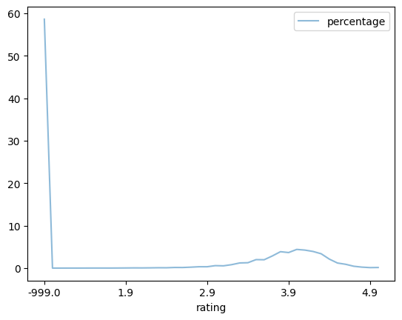
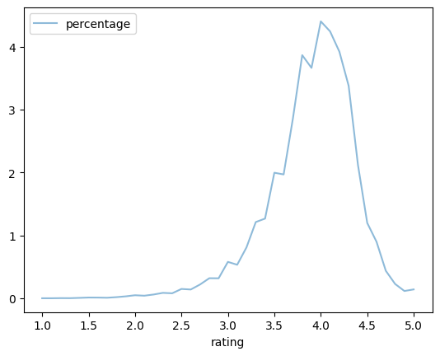
RESULTS
Distribution of Restaurant Ratings
Distribution of Restaurant Ratings (Excluding Missing Data)

Slide 8
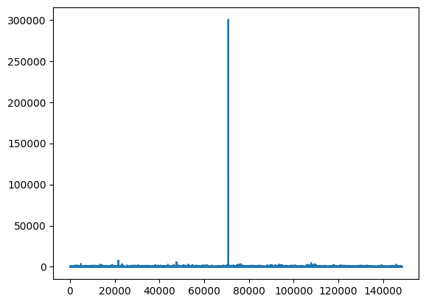
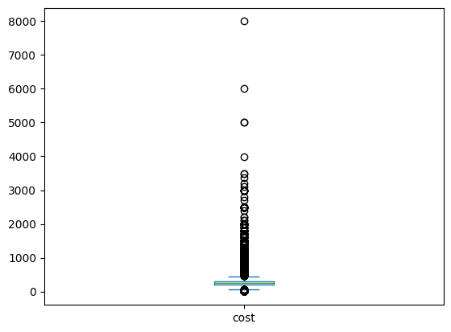
Variation in Meal Costs Across Restaurants
Statistical Distribution of Meal Cost for Two

Slide 9
CONCLUSION
The analysis of Swiggy's restaurant data provides valuable insights into how the platform is performing and where opportunities lie. Major cities like Bangalore, Delhi, and Mumbai are hotspots for restaurant listings, while smaller cities like Pune and Chandigarh show promise for further growth. Most restaurants have ratings between 3.0 and 4.5, which indicates that customers are generally satisfied, though the few low-rated restaurants suggest areas where quality can be improved. When it comes to cost, mid-range restaurants priced between ₹300 and ₹800 are the most popular, offering a good balance of quality and affordability, while highend restaurants with prices above ₹2,500 appeal to a smaller but highly satisfied audience. North Indian and Chinese cuisines remain customer favorites, but global cuisines like Italian and Mexican are becoming increasingly popular in metro cities. These insights suggest that Swiggy can grow by onboarding more restaurants in smaller cities, promoting top-rated eateries, addressing quality concerns, and catering to evolving customer tastes. By focusing on these strategies, Swiggy can continue to enhance the dining experience for its customers and strengthen its presence in the competitive food delivery market.

Slide 10
REFERENCES
Swiggy Data (Kaggle)
Tools: Jupyter Notebook.
Libraries Used: Pandas, NumPy, Matplotlib, Seaborn.

Slide 11
THANK YOU

